Slide 1
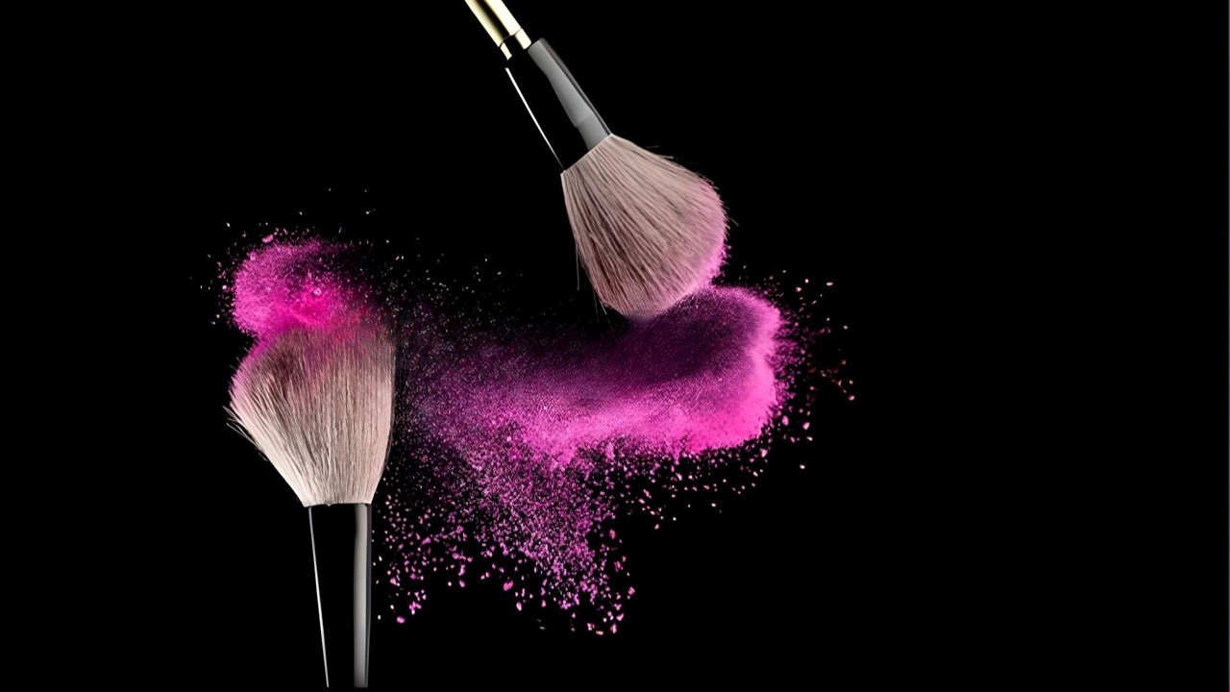

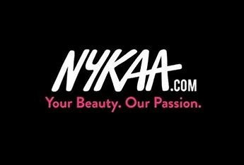
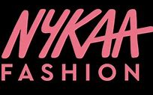
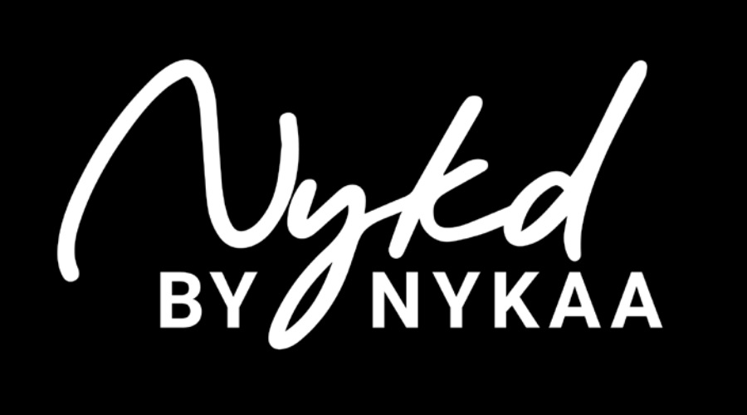

CASE STUDY
By Niraj Devale

Slide 2

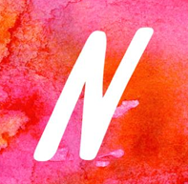

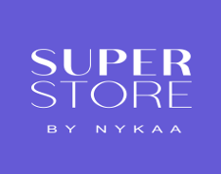

6250+ BRAND PARTNERS
154+ OFFLINE STORES
24 MN+ CUSTOMER BASE
3 BUSINESSES
OFFICIAL BRAND EVENT

Slide 3
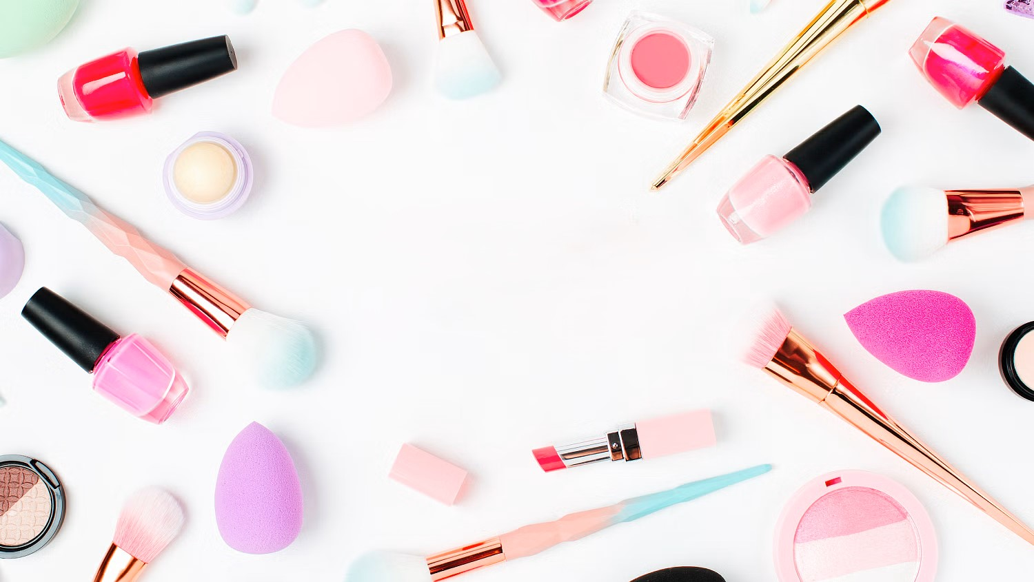
NYKAA 2023 OVERVIEW
GENERAL INFORMARTION
Founded Year: 2012
Primary Industry: Online Beauty Retailer
Category of Operation: BPC, Fashion, Health & Wellness, Home, Perfumes, Footwear & Accessories and more.
Headquarters: Mumbai
CEO: Falguni Nayar
Number of Employees: 3177
Mode of Operation: Physical & Online Stores
IPO Launch: Nov 2021
Market Value: ₹462.53 Bn ($5.55 Bn)
Repeat Customer Rate: 78% (+5%)
SEGMENT | TOTAL ORDERS
Beauty & Personal Care | 34.8 Mn (+31%)
Fashion | 6 Mn (+21%)
Others | 1.4 Mn (+116%)
HIGHLIGHTS OF THE YEAR
GMV: ₹97,433 Mn (+41%)
Revenue: ₹51,438 Mn (+36%)
Gross Profit: ₹22,781 (+39%)
Gross Margin: 44.3% (+0.73%)
EBITDA: ₹2560 Mn (+57%)
EBIDTA Margin: 5% (+0.65%)
PAT: ₹210 Mn (-49%)
PAT Margin: 0.4% (-0.69%)
Market Share: 28%
SEGMENT | GMV
Beauty & Personal Care | ₹66491 (+33%)
Fashion | ₹25696 (+47%)
Others | ₹5245 (+204%)
SEGMENT | AOV
Beauty & Personal Care | ₹1857 (+0%)
Fashion | ₹3973 (+17%)
Others | ₹3420 (+25%)

Slide 4
FINANCIAL REVIEW
Nykaa reported a revenue of $51,438 million in the last financial year, marking a year-on-year (YoY) growth of 36.25%. Over the past four financial years, the company has maintained an average YoY growth of 42.73%. Considering the average inflation rate in India of 5.91% over the past five years, Nykaa's revenue growth can be considered robust and substantially higher than the inflation rate. This indicates that the company has effectively capitalized on market opportunities and consumer demand, driving significant top-line expansion.
Nykaa's EBITDA margin for the past four financial years stands positive. Evaluating these figures in comparison to competitors, For instance, Purplle reported a negative EBITDA margin of -41.56%, while Sugar Cosmetics had a negative margin of -16.5%, indicating operating losses. Mamaearth, another competitor, had a lower EBITDA margin of 3.89% compared to Nykaa. While Myntra, a prominent player in the fashion and lifestyle segment, did not disclose its EBITDA margin, Nykaa's positive and relatively stable EBITDA margins suggest that the company has been able to maintain operational efficiency and profitability better than most of its direct competitors in the beauty and personal care space.

Slide 5
FINANCIAL REVIEW
Though Nykaa has exhibited robust revenue growth over the past four financial years, However, the company's profit performance has been mixed. While Nykaa reported a net profit of ₹616.48 million in 2020-2021 after incurring a loss in the previous year, its net profit has been declining, reaching ₹248.21 million in 2022-2023. The net profit margin has also contracted from 2.53% in 2020-2021 to 0.48% in 2022-2023, despite consistent gross profit growth. This trend suggests that Nykaa's profitability has not kept pace with its revenue expansion, potentially due to increased expenses associated with growth initiatives. The company may need to focus on enhancing operational efficiency and cost management to improve its bottom line and maintain sustainable profitability.
Nykaa's financial ratios, including the current ratio and debt to equity ratio, have shown positive trends over the past four financial years. The current ratio has improved, indicating better short-term liquidity, while the debt to equity ratio has decreased consistently, signaling reduced reliance on debt financing. Notably, Nykaa's debt-to-equity ratio of 0.2 is among the lowest compared to its competitors in the beauty and personal care segment, reflecting a lower financial risk profile and a stronger equity base to support growth initiatives.

Slide 6
FINANCIAL REVIEW
While Nykaa has witnessed significant growth in revenue from its beauty and personal care segment over the last three fiscal years, its fashion and other accessory segments have shown relatively flat revenue growth. This suggests that customers may primarily associate Nykaa with beauty products, potentially limiting their inclination to purchase other offerings from the platform. This disproportionate growth across segments raises questions about Nykaa's strategic focus. The company needs to evaluate whether it wants to concentrate on its core beauty and personal care business, where it has established brand recognition and market leadership, or diversify into becoming a comprehensive e-commerce platform akin to Amazon, Flipkart, or Myntra.
While Nykaa has shown significant revenue growth in its home market of India over the past three years, its revenue from outside India, although doubling annually, remains negligible, contributing less than 1% of the total revenue. This lopsided geographical concentration presents a significant growth opportunity for Nykaa. To unlock its full potential and diversify its revenue streams, the company should strategically plan for expanding its footprint in international markets, particularly in low- to middle-income countries. By establishing physical stores and enhancing its services globally, Nykaa can potentially increase its international revenue share multifold in the coming years, mitigating risks associated with excessive reliance on a single market.

Slide 7
INDUSTRY MARKET OVERVIEW
The Beauty and personal care industry is projected to reach $21.86 billion USD in 2024 and is expected to grow to $38.73 billion USD by 2030, with a compound annual growth rate (CAGR) of 10-12%. Meanwhile, the Fashion and apparel sector is forecasted to reach $190 billion USD by 2025 and is anticipated to expand to $365.8 billion USD by 2030, with CAGR of around 14% as per rough estimate. ***(Assumptions based on research findings)
Trends In Industry:
Beauty and wellness converge: Consumers seek products promoting both beauty and holistic well-being, opting for items that not only enhance their appearance but also contribute to their overall wellness. This trend extends beyond traditional skincare and makeup to include products like adaptogenic skincare, which aims to combat stress and promote balance, and beauty supplements designed to support skin, hair, and nail health from within.
Gen Z influence: The preferences of Gen Z consumers profoundly impact the beauty industry, driving trends towards sustainability, inclusivity, and authenticity. Gen Z's emphasis on social and environmental responsibility prompts brands to prioritize ethical sourcing, eco-friendly packaging, and diverse representation in their marketing campaigns.
Growing personal care beneath metros: As urbanization spreads beyond metropolitan areas, the personal care market experiences significant growth in Tier 2 and Tier 3 cities. Increased disposable incomes and access to digital platforms empower consumers in these regions to explore and invest in a wider range of beauty and grooming products.
Vegan, cruelty-free, and clean beauty: The shift towards ethical and sustainable beauty practices continues to gain momentum, with consumers prioritizing products that are not only vegan and cruelty-free but also free from harmful chemicals such as sulphates, parabens, phthalates, formaldehyde, and synthetic fragrances.
Emergence of new brands and indie beauty: The democratization of beauty through digital platforms has paved the way for innovative startups and indie brands to disrupt the industry. These brands leverage social media, influencer partnerships, and direct-to-consumer models to reach and engage with niche audiences seeking unique, high-quality products. By offering innovative formulations, inclusive marketing, and authentic brand stories, indie beauty brands challenge traditional beauty norms and inspire new trends and product categories.
Male grooming revolution: Men's grooming undergoes a significant transformation as societal norms evolve and male consumers become more invested in skincare and grooming routines.

Slide 8
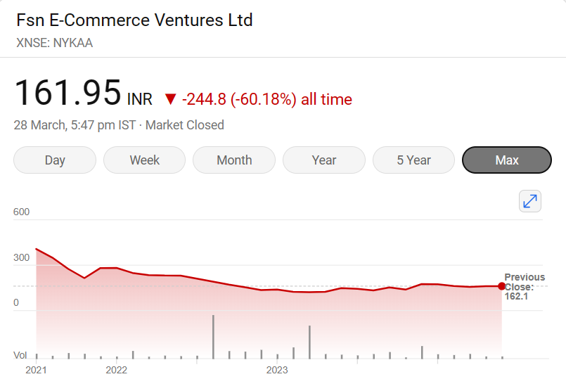


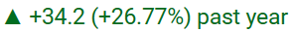
STOCK MARKET SCENARIO
Nykaa's stock has experienced significant volatility, with wide price swings ranging from its all-time high of ₹406.75 to the current level of ₹161.95, reflecting a staggering 60.18% decline. This volatility highlights the dynamic nature of investor sentiment towards the company.
Despite the overall bearish trend, Nykaa's stock has shown signs of recovery, with a 3.55% gain in the past week and a 5.5% increase over the last month, indicating a potential shift in investor sentiment or positive market reactions.
Nykaa's valuation metrics suggest potential overvaluation. With a P/E of 1,012.19, significantly higher than the sector average of 837.68, and a P/B of 28.02, the stock appears to be trading at a premium compared to industry peers. Based on the sector average P/E ratio, Nykaa's stock is potentially overvalued by approximately 20.8%.
The stock's performance over different time frames highlights the shifts in investor sentiment towards Nykaa. While the recent upswing suggests renewed optimism, the substantial decline from the all-time high underscores the need for the company to manage market expectations effectively to maintain investor confidence.

Slide 9
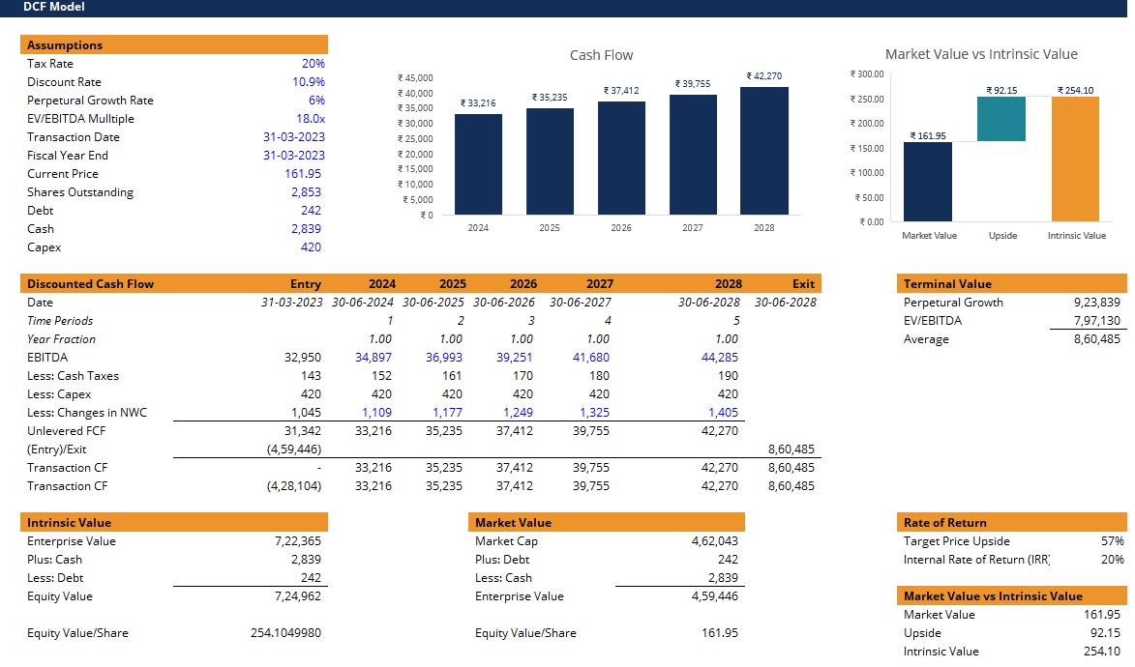
DCF ANALYSIS
Note: This DCF model is provided for informational purposes only. It's based on publicly available Nykaa’s financial statements and my interpretation of DCF methodology. However, financial projections are inherently uncertain, and actual performance may differ. Caution should be exercised, and additional research should be conducted before making investment decisions.

Slide 10
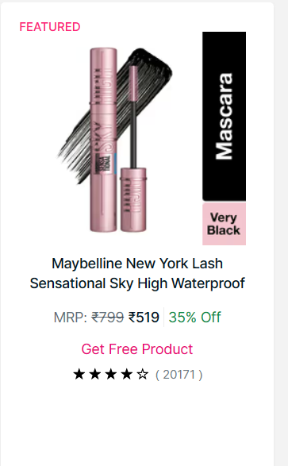
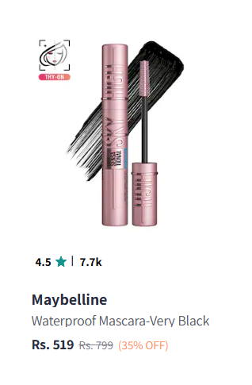
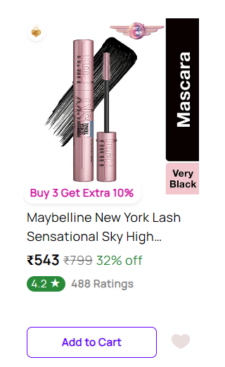
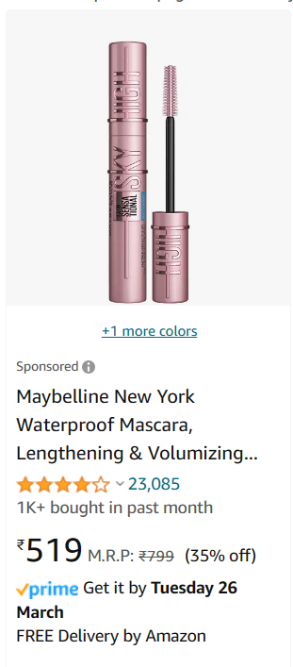
COMPETITOR PRICING ANALYSIS (1/3)
Nykaa
Myntra
Purplle
Amazon
Nykaa's pricing strategy appears to be in line with its competitors, offering relatively similar prices for products in the beauty and personal care segment. This pricing parity with industry peers is a positive sign, as it suggests that Nykaa is not engaging in aggressive discounting or undercutting tactics, which could potentially harm profitability and trigger price wars. Instead, the company seems to be adopting a standard pricing approach, aligning itself with the market norms and maintaining a level playing field.
**Note/Disclaimer: This analysis is based on spot pricing data retrieved from the websites of respective brands. It does not encompass a comprehensive historical pricing analysis and should be interpreted with this limitation in mind.

Slide 11
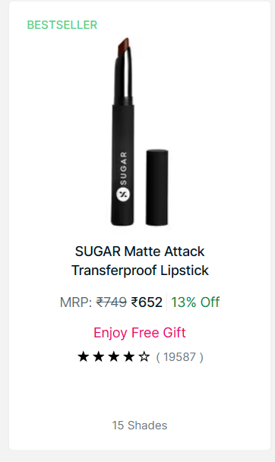
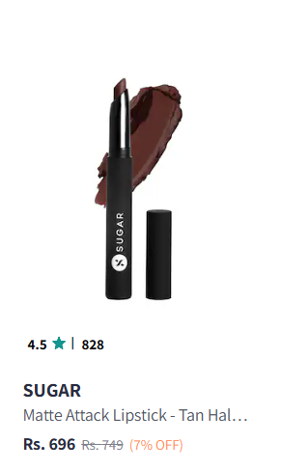
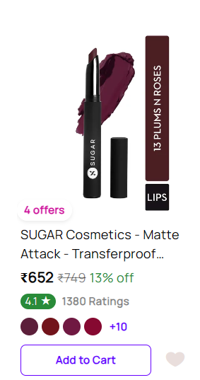
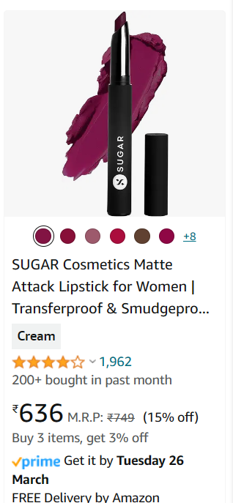
COMPETITOR PRICING ANALYSIS (2/3)
Nykaa
Myntra
Purplle
Amazon
Nykaa's pricing strategy appears to be in line with its competitors, offering relatively similar prices for products in the beauty and personal care segment. This pricing parity with industry peers is a positive sign, as it suggests that Nykaa is not engaging in aggressive discounting or undercutting tactics, which could potentially harm profitability and trigger price wars. Instead, the company seems to be adopting a standard pricing approach, aligning itself with the market norms and maintaining a level playing field.
**Disclaimer: This analysis is based on spot pricing data retrieved from the websites of respective brands. It does not encompass a comprehensive historical pricing analysis and should be interpreted with this limitation in mind.

Slide 12
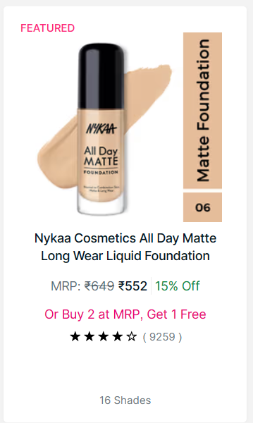
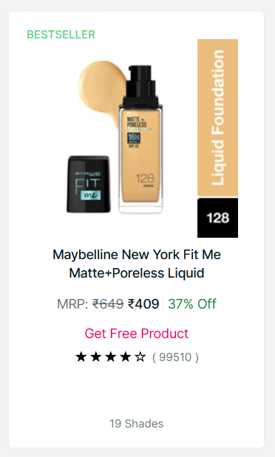
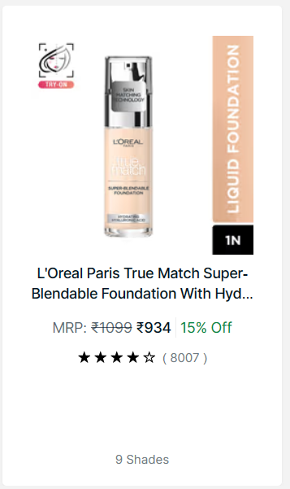
COMPETITOR PRICING ANALYSIS (3/3)
A pricing analysis conducted on matte foundation products offered by Nykaa, Maybelline, and L'Oreal, available on Nykaa's website, reveals competitive pricing across brands. Nykaa's matte foundation is priced at Rs. 552, while Maybelline offers a similar product at Rs. 409, and L'Oreal at Rs. 934. Despite fair pricing, the bestseller status of Maybelline's matte foundation, highlighted by over 100k ratings on Nykaa's website, underscores the importance of Nykaa's own beauty product offerings.
To compete effectively and drive sales growth, Nykaa may need to focus not only on marketing but also on enhancing the quality and appeal of its proprietary beauty products. Merely offering competitive pricing may not be sufficient; the company needs to invest in product development, innovation, and building a strong brand reputation to gain customer trust and loyalty. By elevating the quality of its in-house products to match or surpass the standards set by popular brands like Maybelline, Nykaa can potentially increase the sales of its own product lines and capture a larger share of the market.

Slide 13
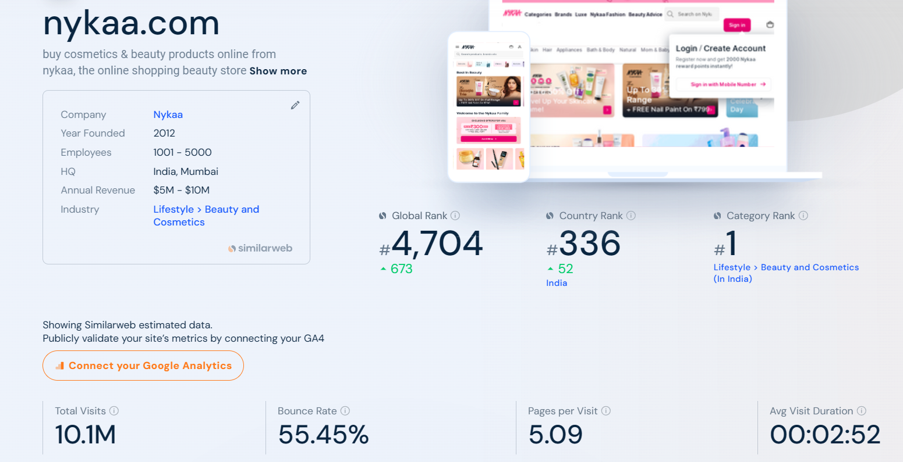
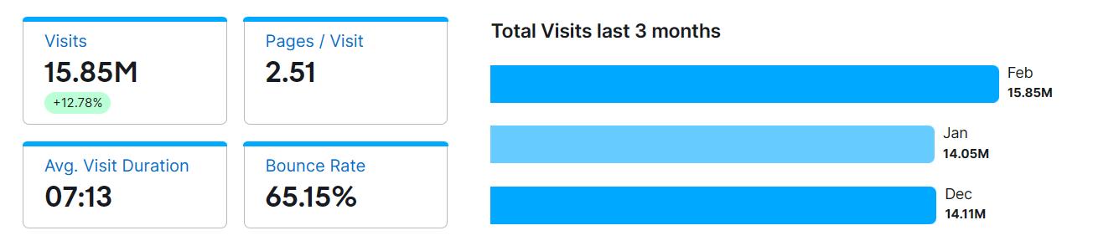
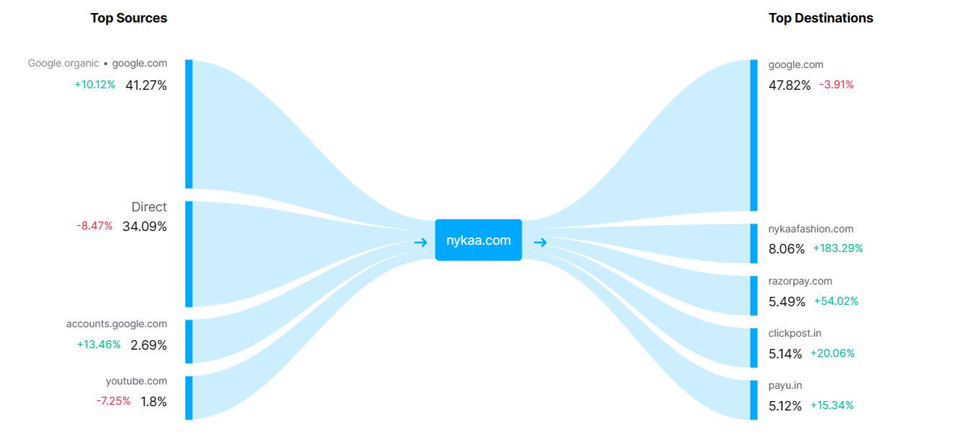
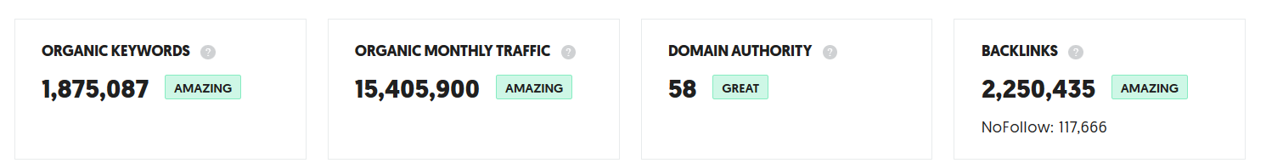
SEO ANALYSIS (1/3)

Slide 14
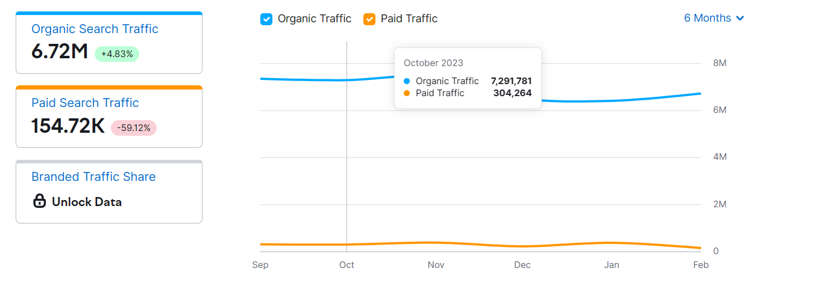
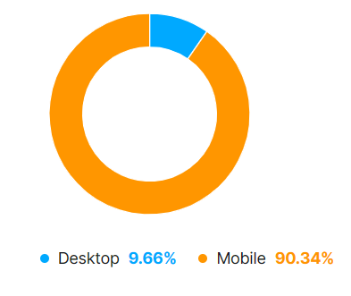
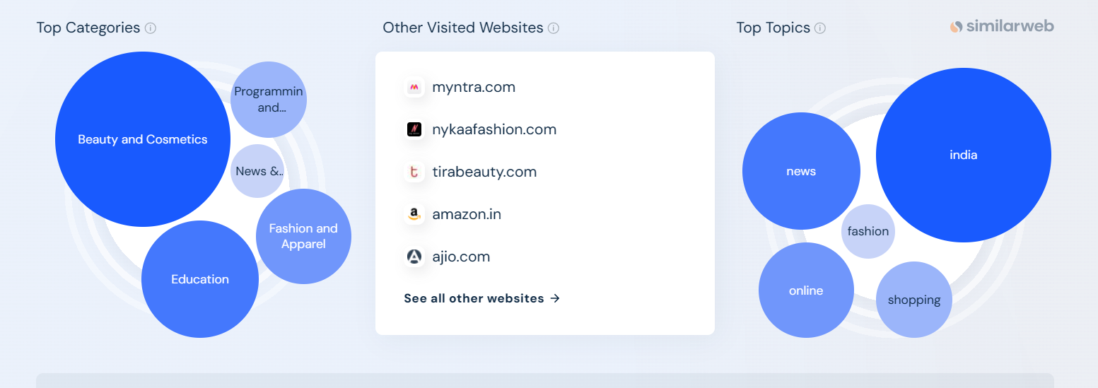
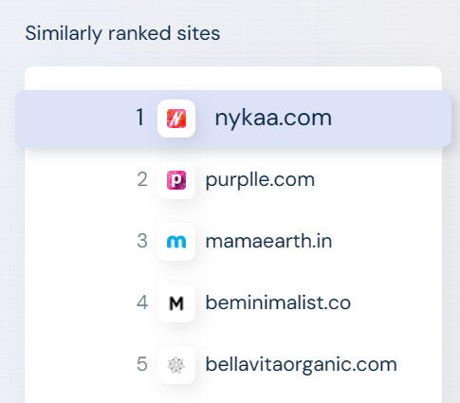
SEO ANALYSIS (2/3)

Slide 15
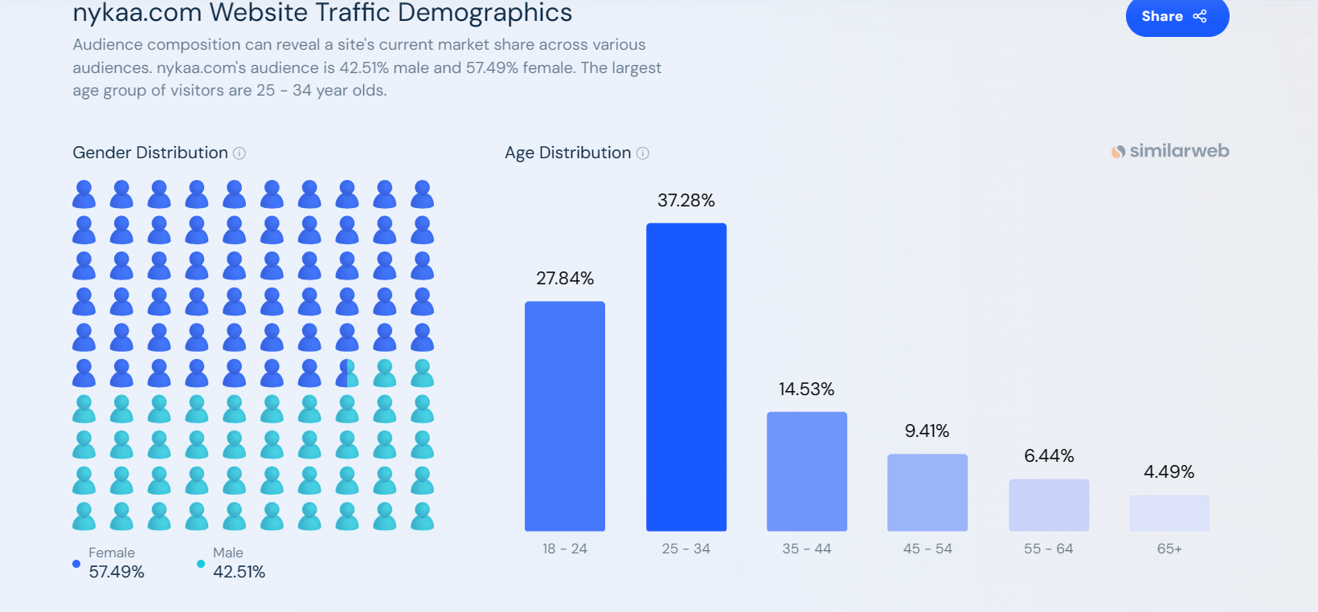
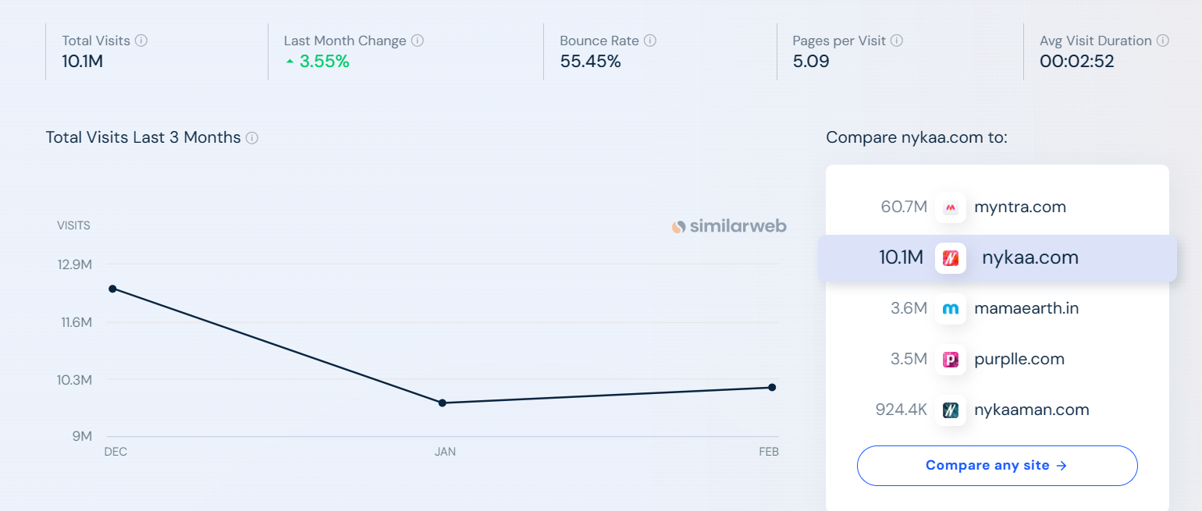
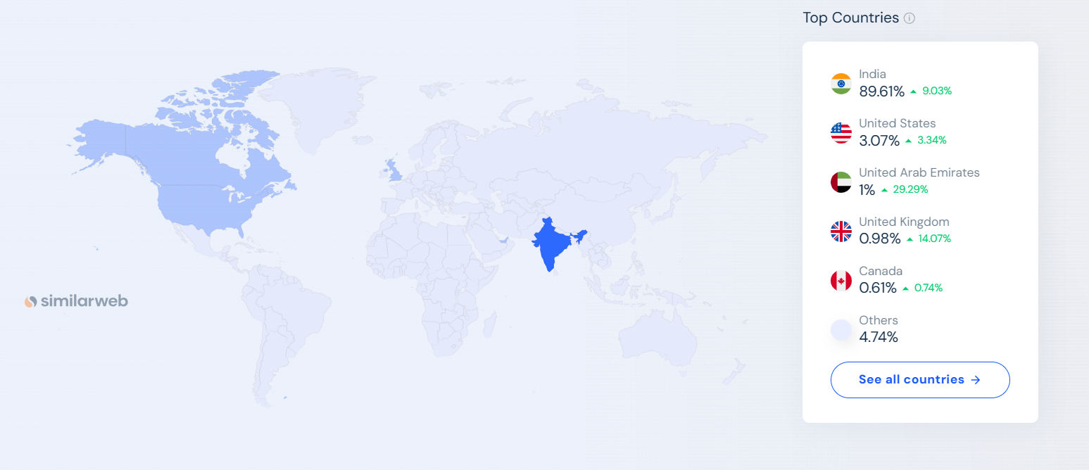
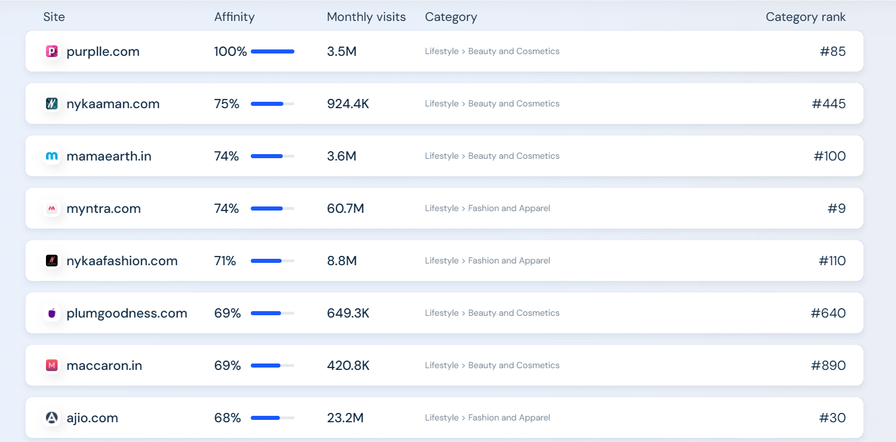
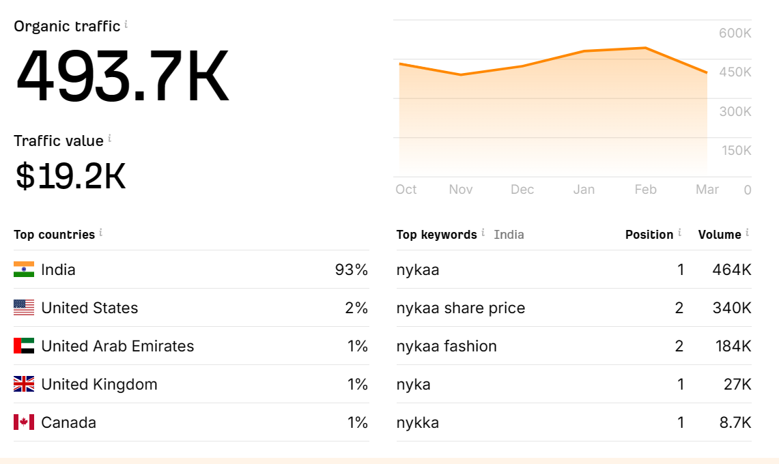
SEO ANALYSIS (3/3)

Slide 16
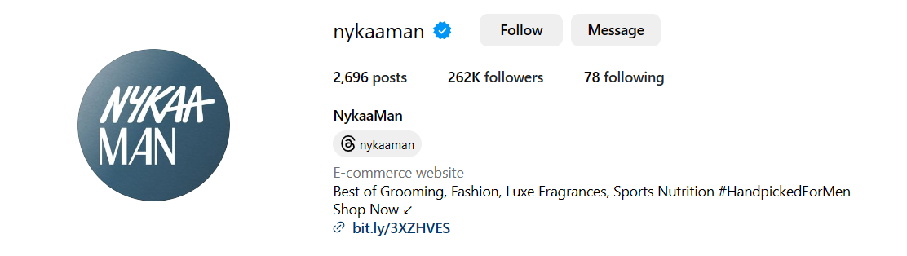
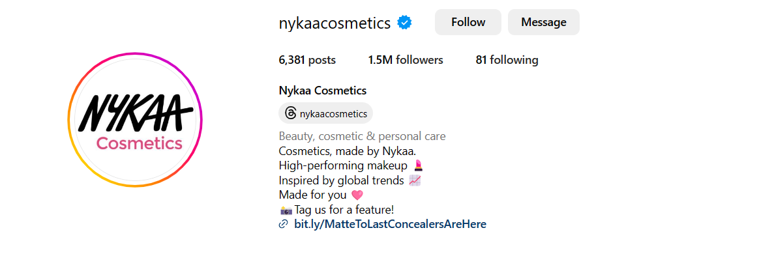
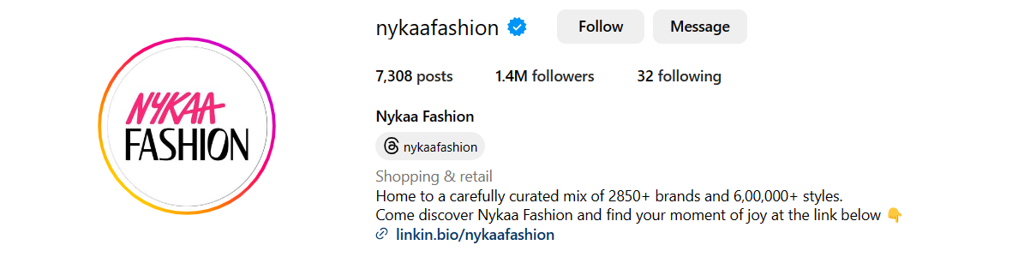
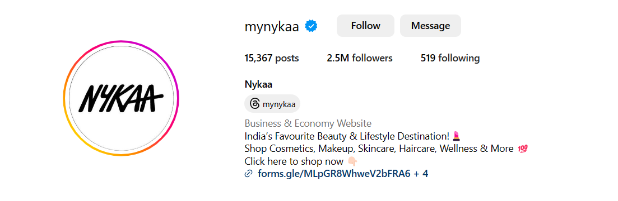
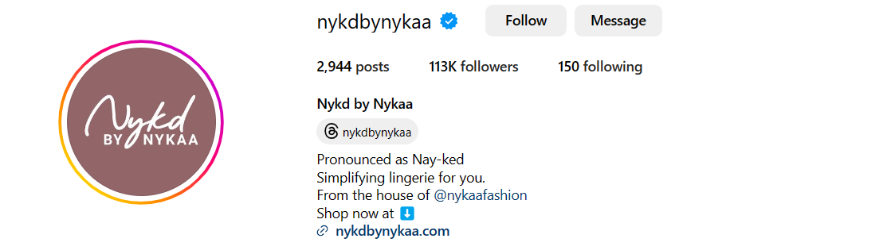

SOCIAL MEDIA PRESENCE
More than
6.2 Mn followers on Instagram

Slide 17
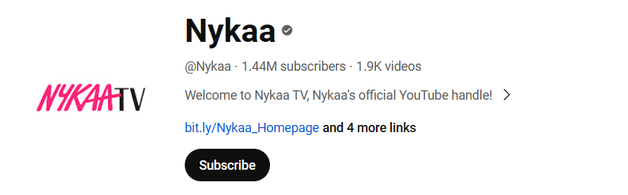
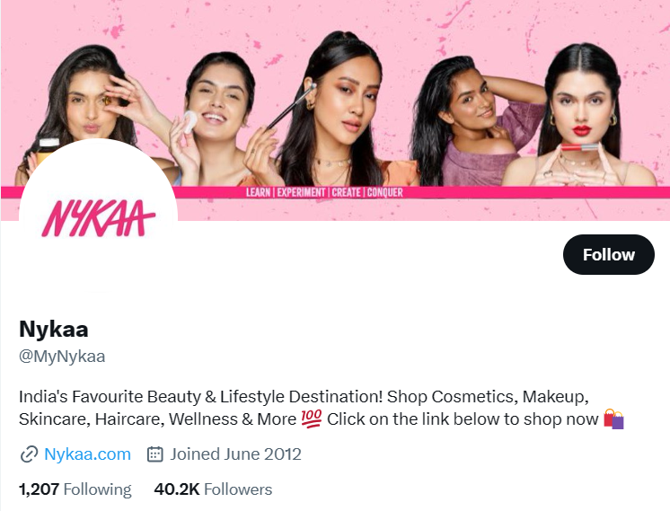
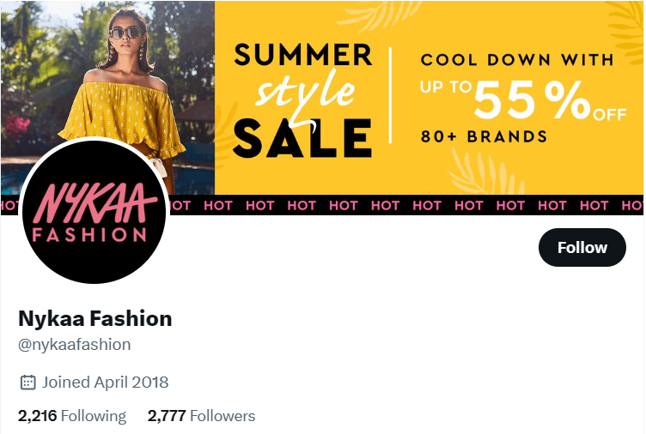
SOCIAL MEDIA PRESENCE
1.4 Mn subscribers on Youtube and 43k followers on Twitter(X)
Nykaa boasts a robust social media presence with millions of followers across platforms, including Instagram, YouTube, and Twitter. This strong presence enables Nykaa to regularly share videos and posts on new beauty and fashion trends, fostering engagement and connection with its audience. It also enhances brand value and facilitates easy customer interaction, crucial for a growing brand like Nykaa to expand its customer base and increase brand loyalty.
With over 6.2 million followers on Instagram, 1.4 million subscribers on YouTube, and 43,000 followers on Twitter, Nykaa maintains an active and engaging social media strategy. Continuously updating followers with the latest beauty and fashion trends not only strengthens the brand's online presence but also provides a platform for customers to connect, share feedback, and seek assistance, contributing to Nykaa's growth and success in the beauty and fashion industry.

Slide 18
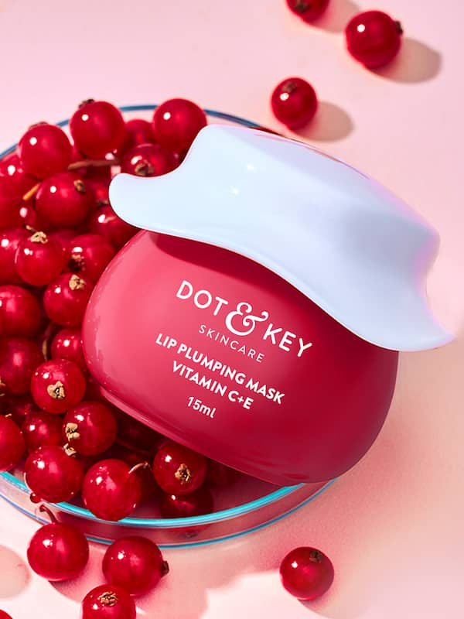


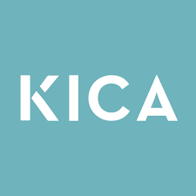

RECENT ACQUISITIONS
In Oct 2021, Nykaa acquired 51% in Dot & Key Wellness Private Ltd (Dot & Key) through the subscription and purchase of equity shares.
In April 2022, The company has announced the acquisition of an 18.51% stake in clean beauty brand Earth Rhythm for ₹41.65 crore.
In April 2022, The company has announced the acquisition of 60% stake in Nudge Wellness for ₹3.6 crore.
In April 2022, The company has announced the acquisition of 100% stake in athleisure brand KICA for ₹4.51 crore
In Sep 2022, Nykaa announced the acquisition of LBB (Iluminar Media Pvt Ltd), to strengthen its brand discovery and content delivery platform

Slide 19
SWOT ANALYSIS
Nykaa boasts a Diverse Product Portfolio, catering to varied consumer preferences in beauty and fashion. Its Strong Brand Recognition solidifies its position as a trusted and reputable retailer. Curated Content & Community Building initiatives foster customer engagement and loyalty, while Collaborations and Exclusivity Deals enhance its appeal. Additionally, Nykaa enjoys a high repeat customer rate, indicative of customer
satisfaction and brand loyalty.
Dependence on Third-Party Brands exposes Nykaa to fluctuations in brand availability and pricing. Intense Competition in the beauty and fashion industry poses challenges to market share and differentiation. Operational Costs of Physical Stores can strain resources and profitability, while scaling Private Label offerings may present challenges.
Furthermore, limited investment in research and
development may hinder innovation and product
differentiation.
S W
O T
Geographical Expansion both within India and outside
presents growth opportunities for Nykaa. Enhancing the
Digital Experience can improve customer engagement and accessibility. Strengthening Private Labels can increase brand exclusivity and margins. Embracing Sustainability and Clean Beauty trends aligns with evolving consumer preferences. Additionally, expanding into Men’s Grooming, Personal Care, and Health and Wellness categories can diversify Nykaa's product offerings and customer base.
Intense Competition remains a significant threat,
necessitating continuous innovation and
differentiation. Changing Consumer Preferences require Nykaa to stay agile and responsive to market trends. Operational Challenges in Physical Stores may impact efficiency and profitability. The rise of Direct-to-Consumer Brands poses a threat to traditional retail models, while Technological Disruptions may require Nykaa to adapt rapidly to evolving digital landscapes.

Slide 20
PORTERS ANALYSIS
Bargaining Power of Suppliers
(Low to Moderate)
Bargaining Power of Suppliers
The bargaining power of suppliers is Low to Moderate due to the multiple suppliers in the market, certain components may have limited suppliers or require specialized manufacturing processes, giving those suppliers some leverage.
Threat of Substitutes
The threat of substitutes is Low. This is because there are limited alternative technologies available that can adequately replace satellite-based solutions.
Threat of New Entrants
The threat of new entrants is Moderate. This is primarily due to the high initial capital investment required for satellite development, regulatory hurdles related to spectrum allocation and licensing.
Bargaining Power of Buyers
Buyers power is Moderate to High. Buyers varies depending on factors such as the volume of satellite purchases, the level of differentiation among satellite offerings, and the availability of alternatives.
Degree of Competition
The Market exhibits a High degree of competition. Companies compete based on factors such as satellite performance, reliability, cost, and value-added services.
Threat of Substitutes
(Low)
Degree of Competition (High)
Threat of New Entrants
(Moderate)
Bargaining Power of Buyers
(Moderate to High)
Market condition:
Small satellite & medium satellite market offers growth opportunities, companies operating in this space must navigate competitive pressures, regulatory challenges, and technological advancements to maintain their competitive edge.

Slide 21
VALUE CHAIN ANALYSIS
FIRM INFRASTRUCTURE
(e.g., Technology Infrastructure, Supply Chain Management, Financial Planning, Investor Relations)
HUMAN RESOURCE MANAGEMENT
(e.g., Recruitment of Customer Service, Logistics, Content Creators, Training Programs, Compensation Management)
TECHNOLOGY DEVELOPMENT
(e.g., Website/App Design, Product Design for In-house Brands, Market Research, Data Analytics)
PROCUREMENT
(e.g., Sourcing Beauty Products, Logistics Services, Advertising Services, IT Services)
MARGIN
VALUE
What buyers
are willing to pay
INBOUND LOGISTICS
(e.g., Order Management, Inventory Management, Integration with Suppliers, Warehouse Operations)
OPERATIONS
(e.g., Order Processing, Warehousing, Inventory Management, Physical Store Operations)
OUTBOUND LOGISTICS
(e.g., Order Shipping, Delivery Management, Third-Party Logistics Providers)
MARKETING AND SALES
(e.g., Online Marketing, Social Media, Influencer Collaborations, Advertising Campaigns)
AFTER MARKETING SERVICES
(e.g., Customer Support, Complaint Resolution, Product Returns/Exchanges, Installation Assistance)

Slide 22
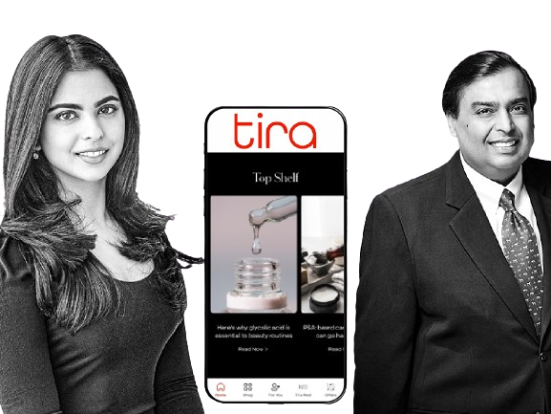
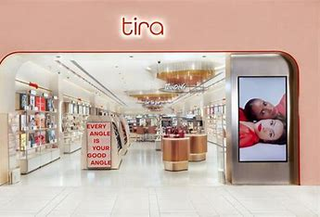
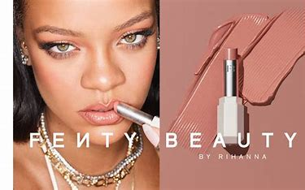
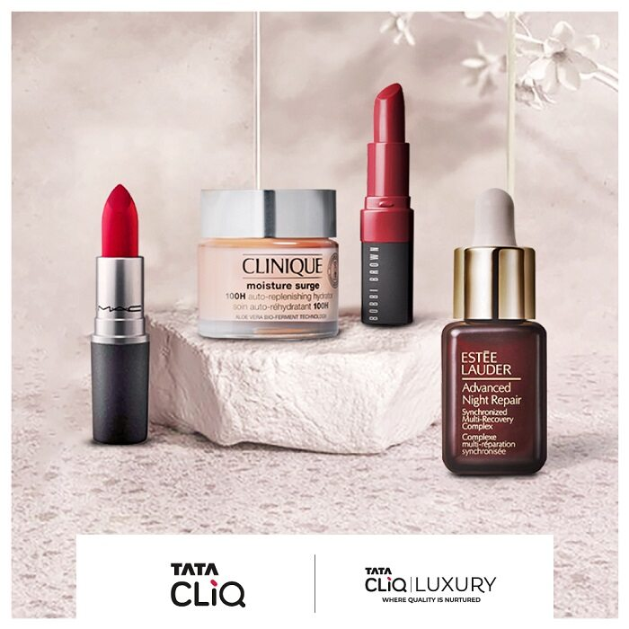
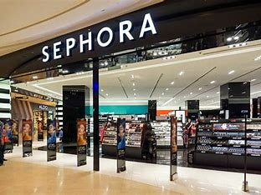
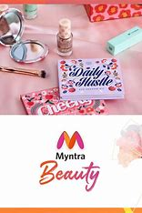

CHALLENGES FOR NYKAA
Retail Rivalry: Tira vs. Nykaa - Reliance's Beauty Showdown
With the launch of Tira, Reliance Retail's foray into the beauty segment with Tira poses a formidable challenge to Nykaa's dominance in the online beauty space. With Reliance's vast resources, deep pockets, and extensive B2C reach, Tira has the potential to disrupt the beauty retail landscape and capture a significant market share.
Tech Turmoil: Nykaa’s Lack of Digital Innovation & Procreation
Tira's advanced tech interventions, such as beauty vending machines, AI-powered fragrance finders, and smart mirrors, provide customers with immersive and personalized shopping experiences. In contrast, Nykaa may face challenges in adopting similar innovative technologies due to existing infrastructure limitations. This technological disparity hampers Nykaa's ability to offer cutting-edge services, potentially impacting customer retention and satisfaction.
Battle of the Beauties: Nykaa vs. The Beauty Giants
Sephora, Tata Cliq, and Myntra's aggressive expansion in the beauty and personal care segments intensifies competition for Nykaa. Despite securing lucrative brand partnerships like Rihanna's Fenty Beauty, Nykaa faces challenges in maintaining its market share against the growing presence of these industry giants. Competitors' strategic advancements in product assortment, customer engagement, and marketing strategies pose threats to Nykaa's brand positioning and customer loyalty.
Competitive Conundrum
Tata, Myntra, Sephora Join the Beauty Fray Nykaa faces intense competition from established players like Tata, which has bolstered its beauty and personal care offerings on Tata CLiQ and opened 20 beauty tech stores. Additionally, Myntra Beauty has registered significant growth, expanding its brand collection, while Sephora remains a formidable player in the beauty retail space.
Stock Shock: Nykaa's Bonus Blunder Erodes Investor Trust
Nykaa's decision to issue a 5:1 bonus share, criticized for its unfavorable impact on existing investors, triggers a loss of investor trust and confidence. This controversy leads to market uncertainty and a decline in Nykaa's stock performance, highlighting challenges in managing investor relations and maintaining transparency. The fallout from the stock issue tarnishes Nykaa's reputation and raises concerns about its corporate governance practices, impacting its ability to attract and retain investors.

Slide 23



NYKAA APP REVIEW
Nykaa boasts three separate apps for fashion, men, and beauty shopping, collectively amassing over 65Mn+ downloads with decent ratings overall. However, this fragmentation poses a significant challenge as users encounter various complaints regarding payment, UI, and bugs, particularly in the fashion and men's apps, potentially leading to customer dissatisfaction and attrition.
The need for three distinct apps adds unnecessary complexity and inconvenience for users. Moreover, the lack of seamless integration between the apps results in subpar user experiences, failing to meet the standards set by competitors like Myntra or Amazon, Flipkart. Users are unlikely to download and manage multiple apps, especially when they can find similar services in one app elsewhere.
Consolidating all three apps into a single, comprehensive platform would offer users a one-stop solution for fashion, men, and beauty shopping, eliminating the need to navigate between multiple apps. By focusing on enhancing the performance and user experience of this unified app, Nykaa can address customer complaints, improve satisfaction, and compete more effectively in the market.
A unified app would not only streamline the shopping experience but also attract more consumers and drive higher app downloads and usage. This approach aligns with the evolving preferences of users who seek convenience and efficiency in their shopping journeys, ultimately benefiting Nykaa's overall business growth and success.
This will eventually reduce the burden on Nykaa's tech team. With fewer apps to manage, the tech team can allocate more resources to innovation and integration of new tools, AI, and other advanced technologies. This approach aligns with the evolving preferences of users who seek convenience and efficiency in their shopping journeys, ultimately benefiting Nykaa's overall business growth and success.

Slide 24
CONCLUSION
Nykaa has emerged as a trailblazer in the Indian beauty and personal care industry, achieving remarkable success with its online presence and exponential growth over the past years. The company's journey exemplifies the power of innovation, customer-centricity, and strategic business acumen. However, to cement its position as the undisputed leader in this rapidly evolving landscape, Nykaa must continue to adapt and evolve, embracing new growth opportunities for being as market leader in BPC segment.
Moreover, Nykaa should prioritize research and development, as well as technological innovation, to enhance its digital platforms, reduce technical issues, and provide a seamless customer experience. Consolidating its various apps into a unified platform could further streamline the user journey and drive engagement.
Secondly, improving logistics and supply chain management is crucial to ensure timely and efficient product delivery across Indian tier 1,2,3 cities and expanding reach till remote areas, thereby elevating customer satisfaction levels. This could be achieved through strategic partnerships, infrastructure upgrades, and leveraging advanced analytics and optimization techniques.
Thirdly, Nykaa should consider expanding its physical retail presence, selectively establishing stores in countries with similar consumer profiles to India, such as Nepal, UAE, Thailand, and Indonesia. This omnichannel approach could create a more immersive brand experience and tap into new markets, driving international growth.
Furthermore, Nykaa should focus on increasing its portfolio of personal brand and private label products, which offer higher profit margins and contribute to revenue growth. Strategic acquisitions and strategic partnerships within the fashion and beauty segments could also propel Nykaa's diversification and market dominance.
Lastly, Nykaa must continue to foster a culture of innovation, customer-centricity, and operational excellence. By embracing these core values and addressing emerging challenges proactively, Nykaa can solidify its position as the premier destination for beauty and personal care products, setting new benchmarks for the industry.

Slide 25
THANK YOU
Contact: Niraj Devale
nirajdevale210@gmail.com
LinkedIn

